Slide 1
Omics Data Analysis of Root-Microbe Interactions
Lecturer Assistant
Tian Tian
Plant Genetics – Department of Molecular Life Sciences – School of Life Sciences
Notes:
Hey everyone! I’m Tian Tian, your Lecturer Assistant for this class. Great to see you all here. Today we’re going to go through the topic of “Omics Data Analysis of Root-Microbe Interactions” — As you all know, this is part of course of “Genetics and Genomics of Root-Microbe Interactions ”led by Prof.Yu. I’ll try to keep it clear and to the point. Let’s get started!

Slide 2
Main content
I Omics Data in Root – Microbe Studies (May 21)
II Key Statistical Metrics in Microbiome Analysis (May 28)
III Root transcriptome data analysis (June 4)
IV Gene Expression – Microbiome Co-regulation Networks (June 11)
Plant Genetics – Department of Molecular Life Sciences – School of Life Sciences
Notes:
This is the main content of the course in which I am responsible for. The content will be divided into four main parts corresponding to 4 lessons, focusing on a key area in plant-microbe interaction research, particularly in the context of omics data.
First, we’ll start with Omics Data in Root–Microbe Studies. This will give us a broad overview of the types of high-throughput data that are commonly used to explore interactions between plant roots and microbes.
Next, we’ll move on to Key Statistical Metrics in Microbiome Analysis. This section will introduce you to the main quantitative metrics used to assess microbial community structure, diversity, and similarity. Understanding these metrics is essential for interpreting microbiome data correctly.
After that, we’ll look specifically at the Root Transcriptome Data Analysis. This part will focus on how we analyze gene expression in plant roots and what insights we can gain from transcriptome profiling in the context of microbe interactions.
Finally, we’ll discuss Gene Expression–Microbiome Co-regulation Networks. Here, we’ll connect the dots between part II and III, link host gene expression and microbial community features, construction co-regulation networks and regulatory relationship. This is where systems biology really comes into play.
So with that overview in mind, let’s get started with the first section — Omics Data in Root–Microbe Studies.

Slide 3

I Omics Data in Root – Microbe Studies (21.5)

Slide 4
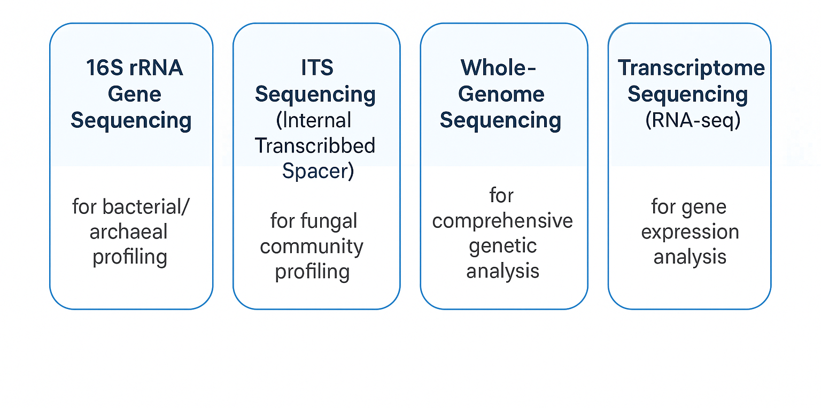
Omics Data in Root–Microbe Studies
Research objective: To understand the main types of omics data relevant to microbiome research.
Notes:
"In microbiome research, especially in root–microbe interactions, we often use different types of omics data to study both the microbes and how the host plant responds to them. This slide shows four key types of sequencing technologies commonly used in these studies."
16S rRNA Gene Sequencing "This method is used to study bacterial and archaeal communities. It targets the 16S ribosomal RNA gene, which is highly conserved among bacteria but has variable regions that help identify different species. It’s a powerful tool for profiling bacterial diversity in root-associated microbiomes.”
ITS Sequencing (Internal Transcribed Spacer) "Similar to 16S, but this one is for fungi. The ITS region is a highly variable DNA sequence located between ribosomal RNA genes, and it's widely used for fungal community profiling. When we want to know what kinds of fungi are present in the root zone, we use ITS sequencing.”
Whole-Genome Sequencing "Instead of targeting a specific gene, this method sequences the entire genome of an organism. It provides comprehensive genetic information and is useful when we want to study the full genetic potential of a host.”
Transcriptome Sequencing (RNA-seq) “This method focuses on gene expression. It sequences the RNA transcripts in a sample, allowing us to understand which genes are being actively expressed. In root–microbe studies, it helps us learn how both the plant and the microbes respond to each other at the molecular level. Transcriptome are dynamic changed all the time, so for one plant you can do hundreds to thousands of RNA sequencing, with different tissues, different developmental stages or different treatments on what you focus. But the plant genome is stable with a low mutation rate that can neglect.
Then, one question, What types of data have you encountered or analyzed before?

Slide 5
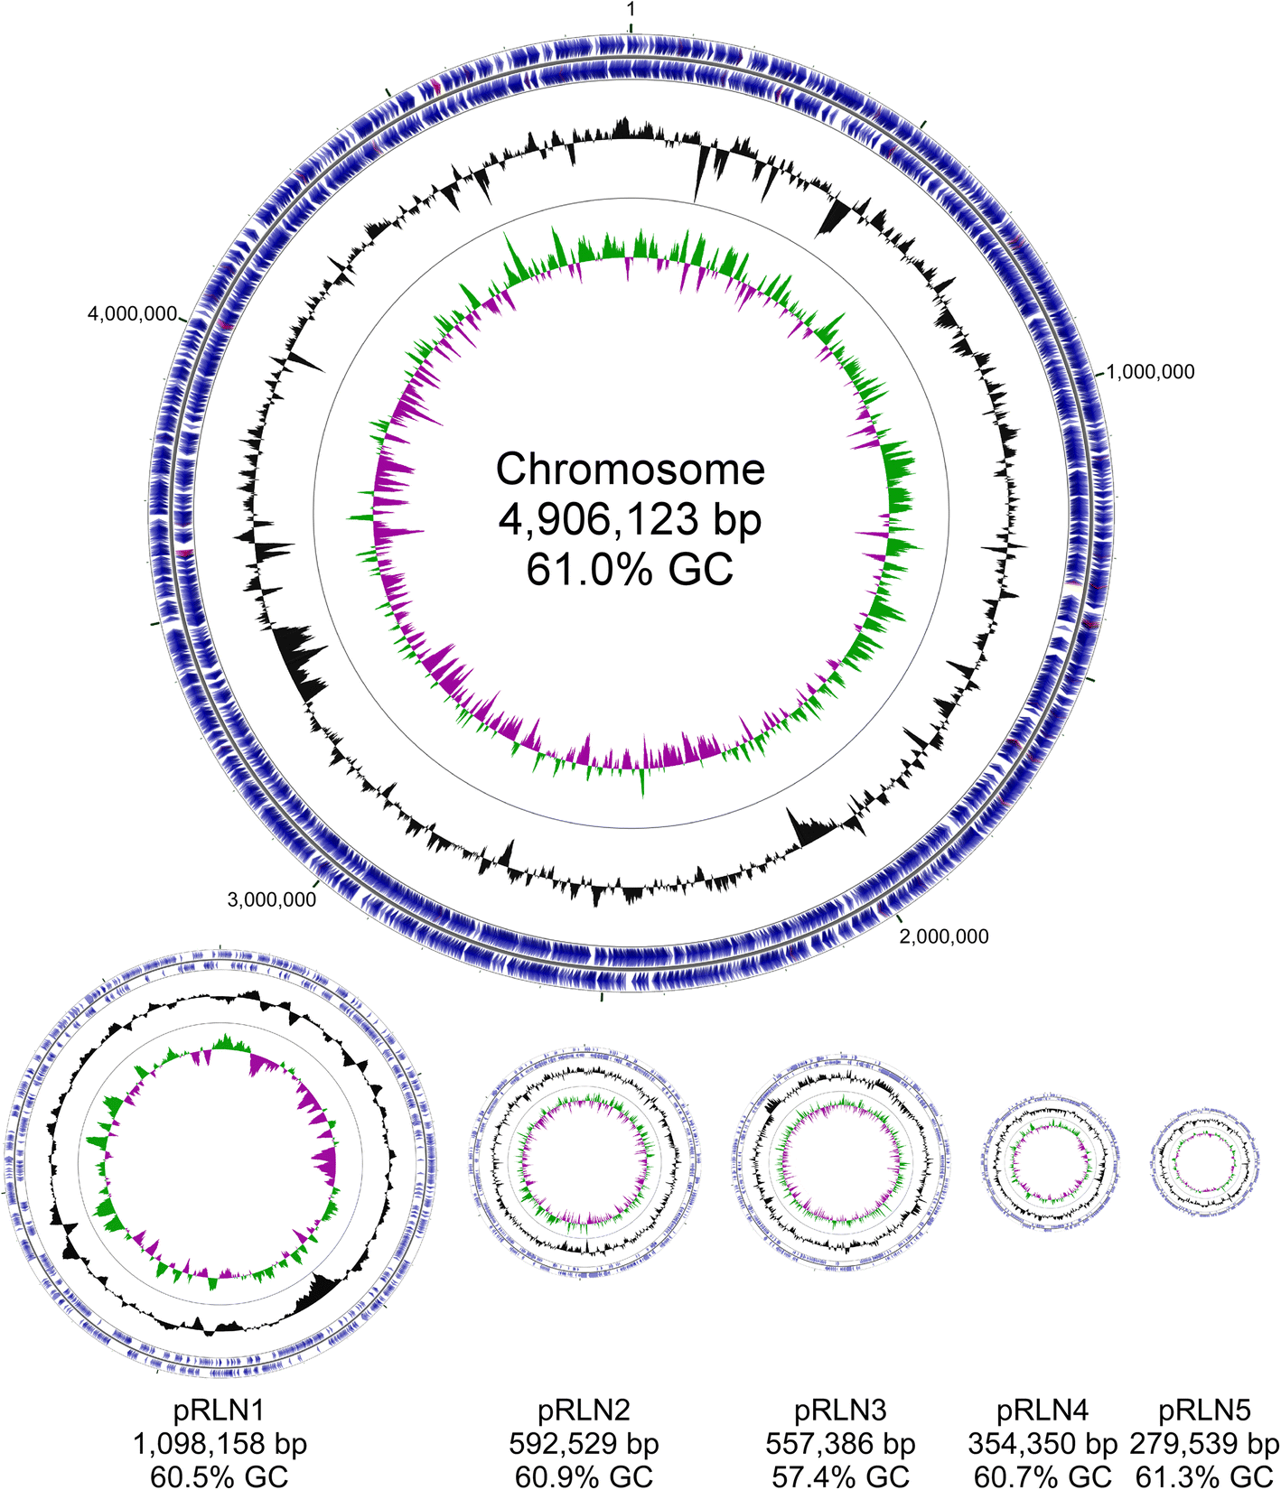
Bacterial genome
Key Features of a Bacterial Genome:
Structure: Single circular chromosome (0.5–10 Mb) + multiple small plasmids.
Size: Highly variable (0.5–10 Mb).
Assembly: Requires strain-level sequencing.
Classification: 16S rRNA gene as key marker.
Explore bacterial genomes: 🔗 MaGe platform: https://mage.genoscope.cns.fr
The chromosome and five plasmids of Rl Norway.
(Liang et al., 2018, Environmental Microbiome)
Notes:
“Now let’s take a closer look at the bacterial genome. Bacteria have some unique genomic features that make them very different from eukaryotic organisms.
🔹 Structure: Most bacterial genomes consist of a single, circular chromosome. The size can vary quite a bit — from as small as 0.5 Mb to as large as 10 Mb. In addition to the main chromosome, bacteria often carry extra genetic elements called plasmids. These are small, circular DNA molecules that can replicate independently and often carry genes related to antibiotic resistance or environmental adaptation.
🔹 Size: As you can see in the diagram, the chromosome in this example is about 4.9 million base pairs long, with a GC content of 61%. Plasmids are smaller, ranging from ~280,000 to ~1 million base pairs, and they vary in GC content as well.
🔹 Assembly: To reconstruct a bacterial genome like this, we need to do strain-level sequencing, which gives us enough resolution to assemble both the main chromosome and any plasmids. This requires good coverage and high-quality data.
🔹 Classification: A key gene we use for bacterial classification is the 16S rRNA gene. It’s present in all bacteria, evolves slowly, and includes conserved and variable regions that help us identify different taxa.
You can also explore bacterial genome structures using the MaGe platform, an online tool that provides annotated genome data for thousands of bacterial strains. The link is available at the bottom of the slide.”

Slide 6
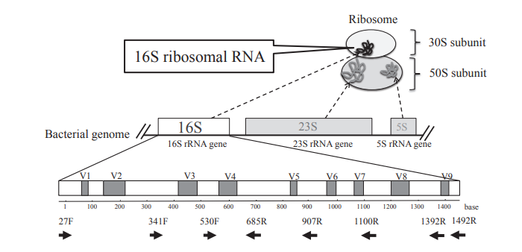
16S rRNA gene
Key Features:
Highly conserved across all bacteria
Contains variable regions for species discrimination
~1,500 bp length (9 hypervariable regions)
Slow evolutionary rate → stable for taxonomy
(Fukuda et al., 2016, J UOEH)
Notes:
“Next, let’s zoom in on this very important gene in microbiome research — the 16S ribosomal RNA gene.
🔹 This gene is highly conserved across all bacterial species, meaning most of its sequence stays the same across different bacteria. This makes it an excellent marker for detecting bacteria in environmental or clinical samples.
🔹 However, within the 16S gene, there are also variable regions — shown here as V1 to V9. These regions differ between species, allowing us to tell different bacteria apart.
🔹 The entire gene is about 1,500 base pairs long, and those 9 hypervariable regions are where most of the species-specific differences lie. In this diagram, you can see commonly used primer pairs, such as 27F, 530F, 907R, which are used to amplify specific variable regions for sequencing.
🔹 Another reason we use this gene is because it has a slow evolutionary rate. That makes it stable and reliable for constructing bacterial phylogenies and doing taxonomic classification.
So in summary, 16S rRNA sequencing is like using a molecular ‘barcode’ to identify and classify bacteria in your samples — a cornerstone method in microbiome studies.”

Slide 7
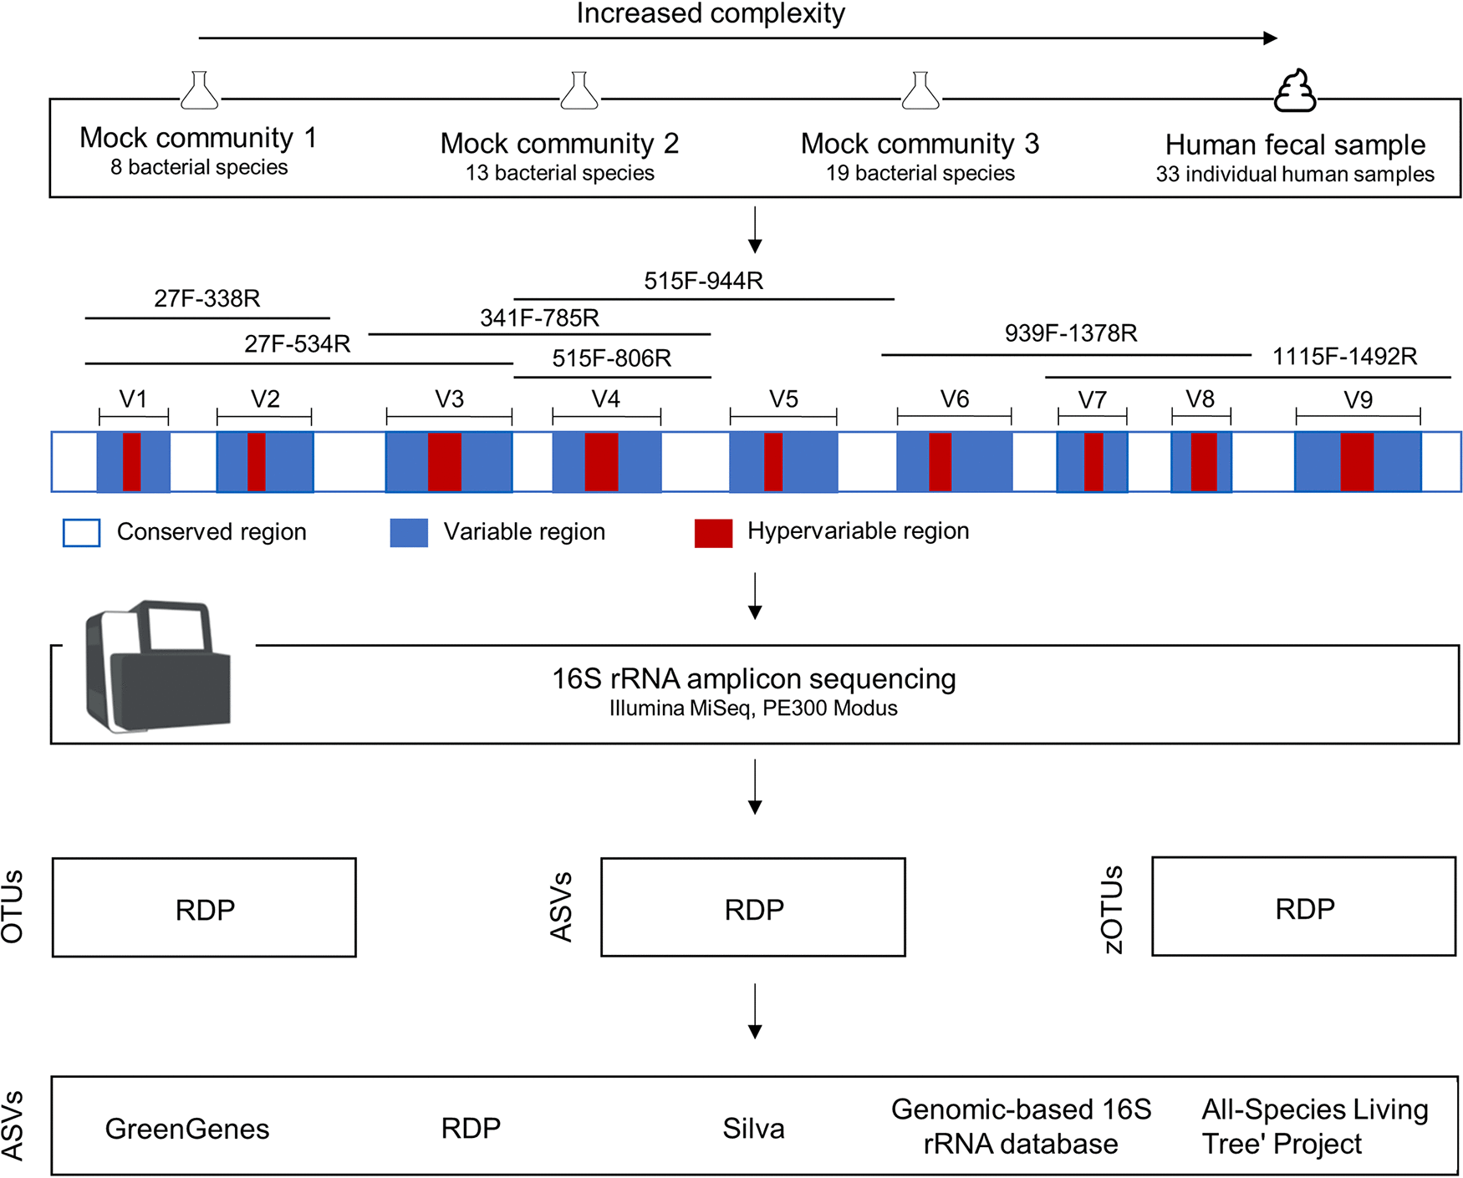
16S rRNA gene amplicon sequencing
Typical Primers in Plant Root Microbiome Research
515F-806R
5′ GTGCCAGCMGCCGCGGTAA 3′
5′ GGACTACHVGGGTWTCTAAT 3′
Amplification length ~250bp
OTU (Operational Taxonomic Unit)
ASV (Amplicon Sequence Variant)
A Higher-Resolution Alternative to OTU Clustering
(Abellan-Schneyder et al., 2021,mSphere)
Notes:
This is a overview of the 16S rNRA gene amplicon sequencing analysis strategies. DNAs from different sample types with increasing complexity (i.e., 3 mock communities and 33 human stool samples) were extracted. Amplicons were generated using different primer pairs targeting different V-regions and sequenced on an Illumina MiSeq. Afterwards, the impacts of different clustering approaches and reference databases on the microbial profiles were investigated. OTU and ASV are the most popular cluster that used in microbiome studies.

Slide 8
16S rRNA gene amplicon sequencing
1. Understanding Raw Sequencing Data
Assess sequencing quality using tools like FastQC or MultiQC.
2. Reads Alignment / Denoising
Clean and denoise reads (e.g., via DADA2, Deblur) or align to reference genomes.
3. Taxonomic Classification
Assign taxonomy using reference databases (e.g., SILVA, Greengenes).
4. Quantification
Generate abundance tables for taxa or functional genes.
Notes:
16S rRNA sequencing is a powerful tool for studying microbial communities. There are the key steps of the analysis pipeline.

Slide 9
Preparation for the upcoming exercises
References
Test datasets
Softwares

Slide 10
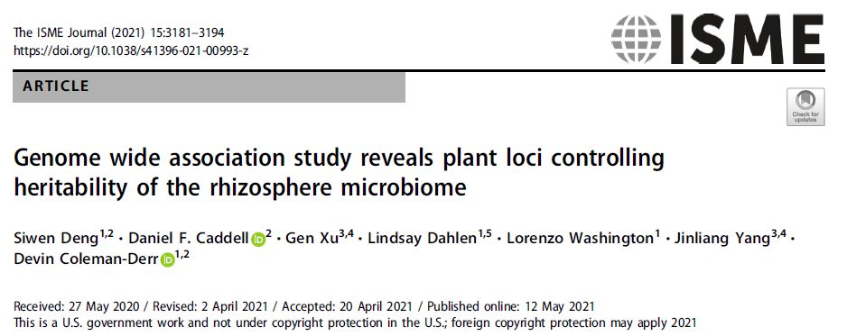
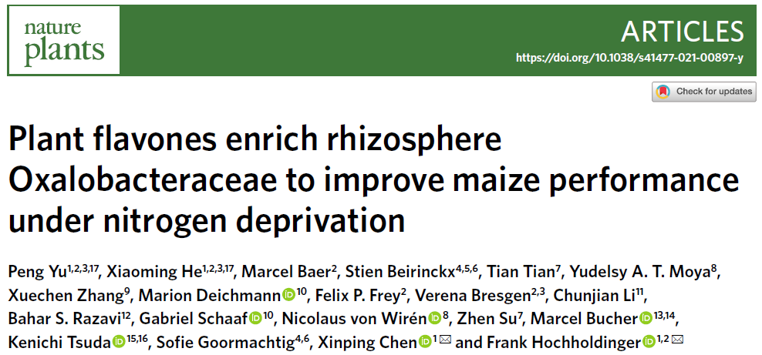
References
1
1

Slide 11
Test datasets
Data type | Download link
16S sequencing raw data | SRR11839631 SRR11839632 SRR11839633 SRR11839634 SRR11839635 SRR11839636 SRR11839637 SRR11839639 SRR11839640
OTU matrix | https://github.com/colemanderr-lab/Deng-2020/blob/master/fig1_24line.rds
RNA-seq raw data | SRR11839278 SRR11839289 SRR11839301 SRR11839312 SRR11839497 SRR11839508 SRR11839619 SRR11839630 SRR11839780
Gene expression matrix | https://github.com/PengYuMaize/Yu2021NaturePlants/blob/master/gene_counts_table_WGCNA.txt
Reference genome | https://download.maizegdb.org/Genomes/B73/Zm-B73-REFERENCE-NAM-5.0/
Notes:
https://
https://download.maizegdb.org/Genomes/B73/Zm-B73-REFERENCE-NAM-5.0/Zm-B73-REFERENCE-NAM-5.0.fa.gzdownload.maizegdb.org/Genomes/B73/Zm-B73-REFERENCE-NAM-5.0/Zm-B73-REFERENCE-NAM-5.0_Zm00001eb.1.gff3.gz

Slide 12
Softwares
Rstudio/R
Conda
sratoolkit (conda install -c bioconda sra-tools)
Hisat2
stringtie
samtools
Install the appropriate version based on your system (Windows, macOS, or Linux).
https://github.com/ttian627/Omics-Data-Analysis-of-Root-Microbe-Interactions

Slide 13
II Key Statistical Metrics in Microbiome Analysis (28.5)
Preparation for the upcoming exercises
Notes:
Hello everyone, welcome to our second class with the topic of “Key Statistical Metrics in Microbiome Analysis”.

Slide 14
Key Statistical Metrics in Microbiome Analysis
Research objective: To understand effective traits through the analysis of microbiome data.
Alpha diversity
Rarefaction analysis
Beta diversity
Taxonomy distribution
Code: https://github.com/ttian627/Omics-Data-Analysis-of-Root-Microbe-Interactions/tree/main/01_16S

Slide 15
Alpha diversity
Alpha diversity is within sample diversity.
species diversity
species evenness
Diversity Index | Description
Shannon Index | Considers both species richness and evenness; sensitive to rare species.
Simpson Index | Measures the probability that two randomly selected individuals belong to different species; more sensitive to dominant species.
Fisher's Alpha | Diversity index based on fitting a log series distribution; good for complex communities.
Notes:
Alpha diversity is within sample diversity. It can quantify the species diversity and evenness. There are multipule of index that can be used to evaluate the diversity of one sample. Shannon Index
is commonly used with higher values indicate greater diversity.

Slide 16
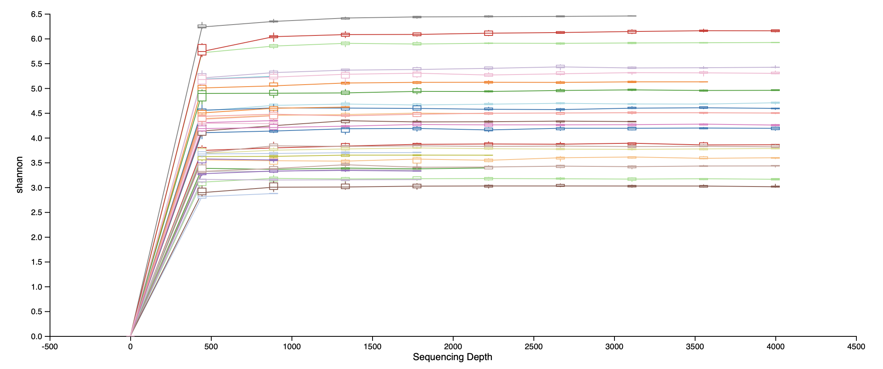
Rarefaction analysis
Rarefaction curve illustrates how the cumulative number of alpha diversity metrics in a sample changes as sequencing depth increases.
From qiime2
Notes:
Rarefaction analysis is used to evaluate alpha diversity across varying sequencing depths / read counts.

Slide 17
Beta diversity
Beta diversity is between sample diversity.
It quantifies the dissimilarity or similarity in species composition between two or more samples.
Beta diversity | Species Composition | Species Abundance | Phylogenetic Tree
Jaccard index | ✅
Sorensen index | ✅
Bray-Curtis distance | ✅ | ✅
Euclidean distance | ✅ | ✅
Weighted UniFrac distance | ✅ | ✅ | ✅
Notes:
Beta diversity is between sample diversity.

Slide 18
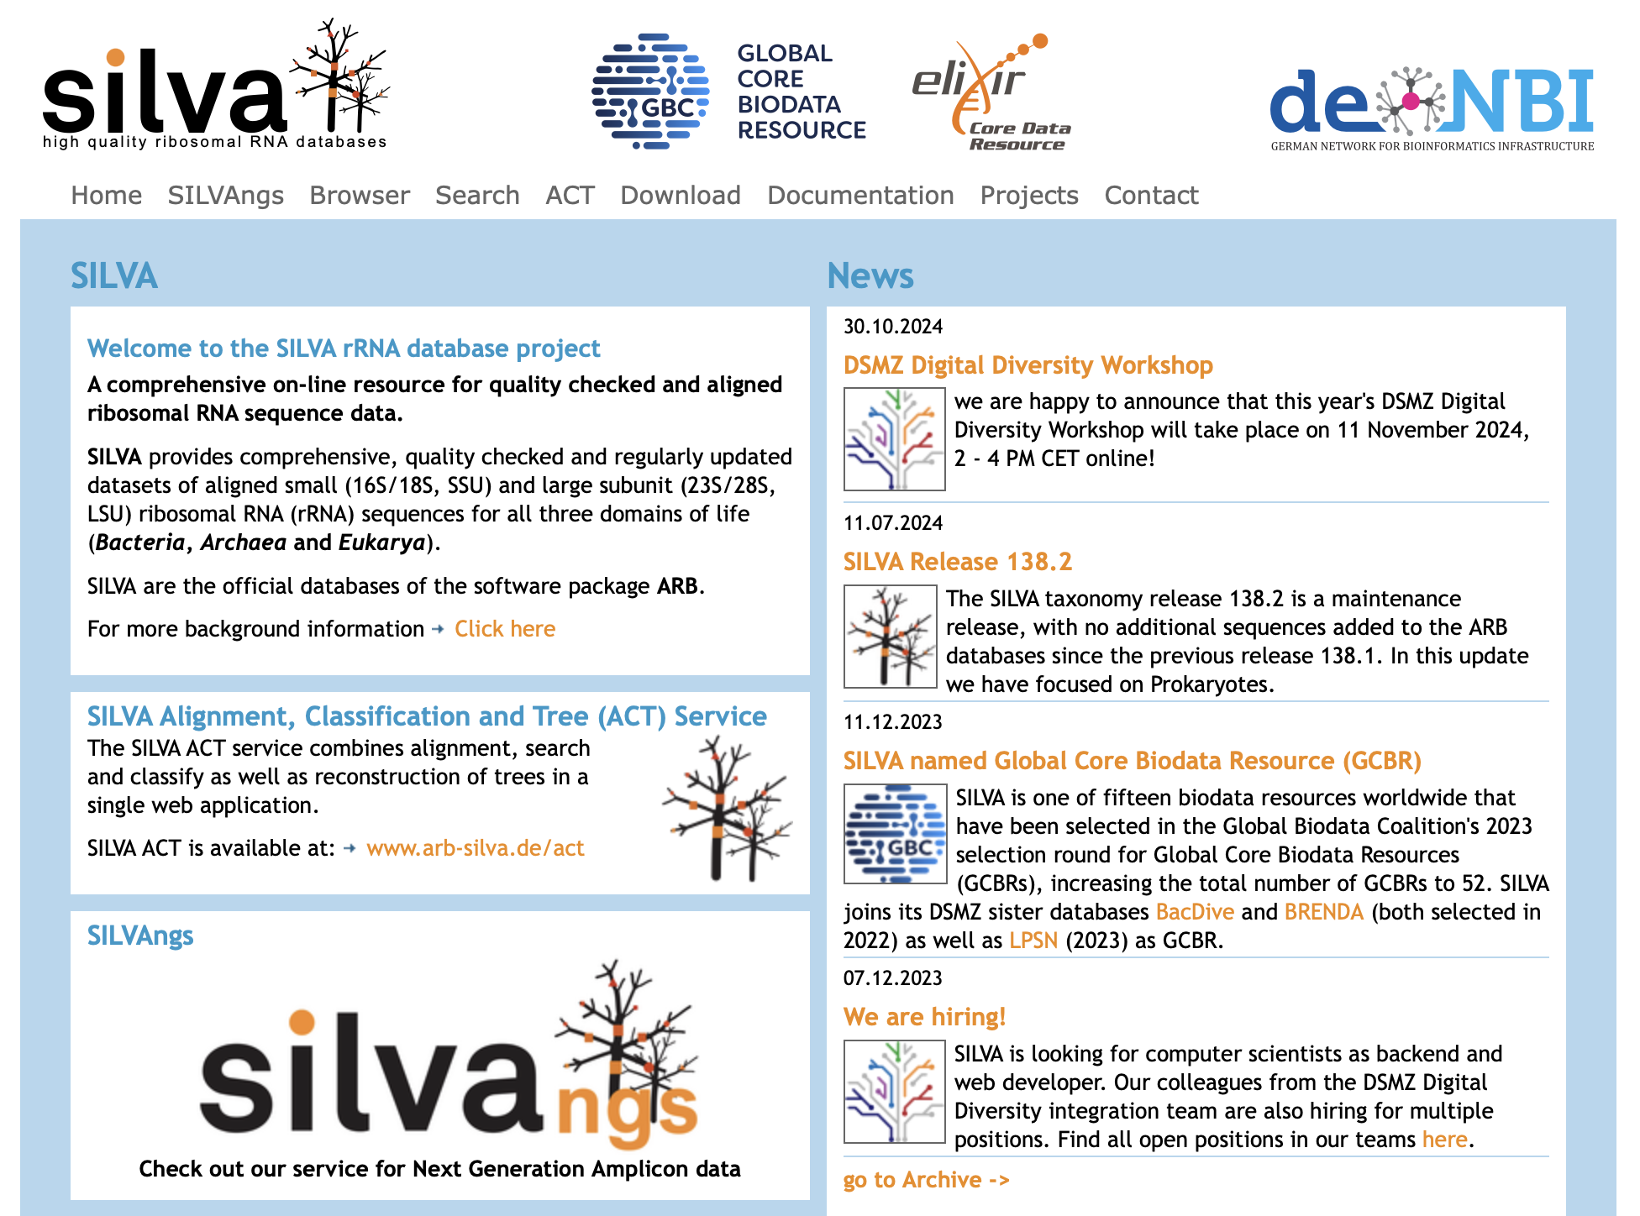
Taxonomy distribution
https://www.arb-silva.de
Notes:
The silva database is a comprehensive on-line resource for quality checked and aligned ribosomal RNA sequence data. After reads alignment, The SILVA microbial database can be used to align OTU or ASV representative sequences for taxonomic classification at different levels, such as phylum, class, order, genus, and species.

Slide 19
16S Data Structure
>rar <- readRDS("fig1_24line.rds")
> rar
phyloseq-class experiment-level object
otu_table() OTU Table: [ 1787 taxa and 204 samples ]
sample_data() Sample Data: [ 204 samples by 5 sample variables ] tax_table() Taxonomy Table: [ 1787 taxa by 6 taxonomic ranks ]
>sample_data(rar)
>otu_table(rar)
>tax_table(rar)
> rar2 <- readRDS("fig3_200line.rds")
rar2
phyloseq-class experiment-level object
otu_table() OTU Table: [ 1189 taxa and 598 samples ]
sample_data() Sample Data: [ 598 samples by 16 sample variables ]
tax_table() Taxonomy Table: [ 1189 taxa by 7 taxonomic ranks ]
phy_tree() Phylogenetic Tree: [ 1189 tips and 1188 internal nodes ]

Slide 20
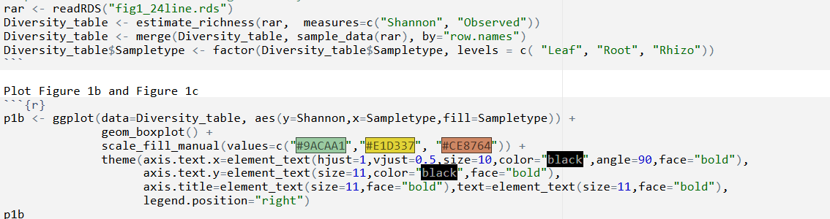
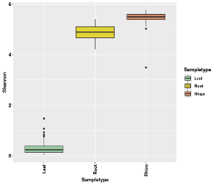
α diversity -shannon
Deng et al., 2021

Slide 21
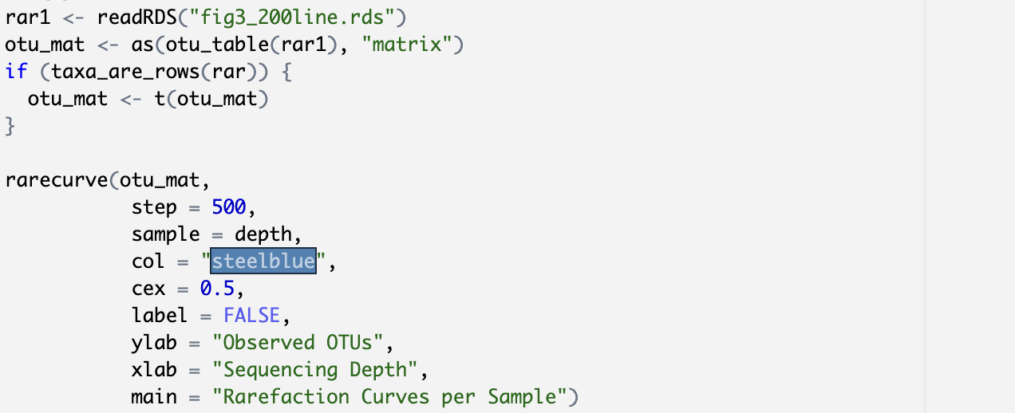
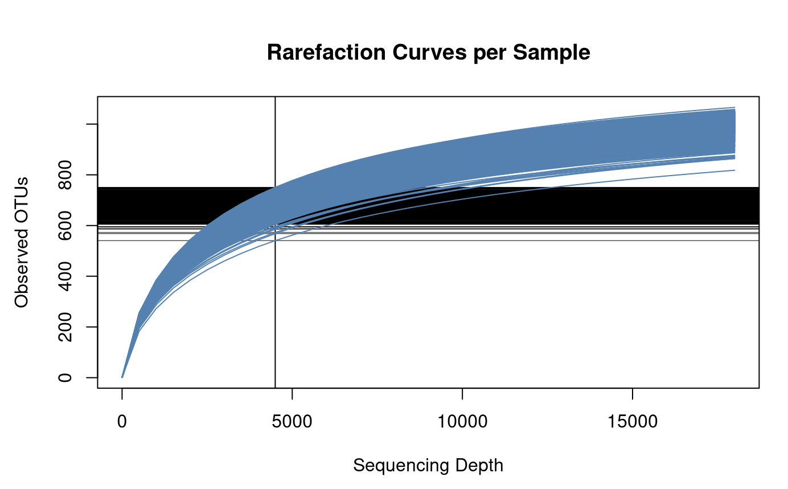
Rarefaction analysis
Deng et al., 2021

Slide 22
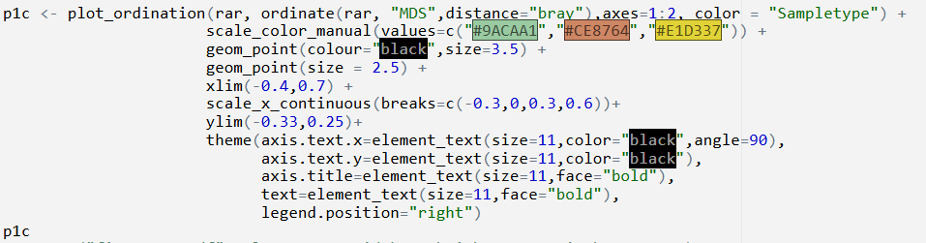
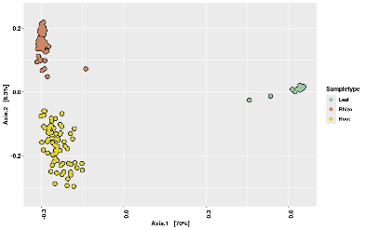
β diversity - Bray-Curtis distance
Deng et al., 2021

Slide 23
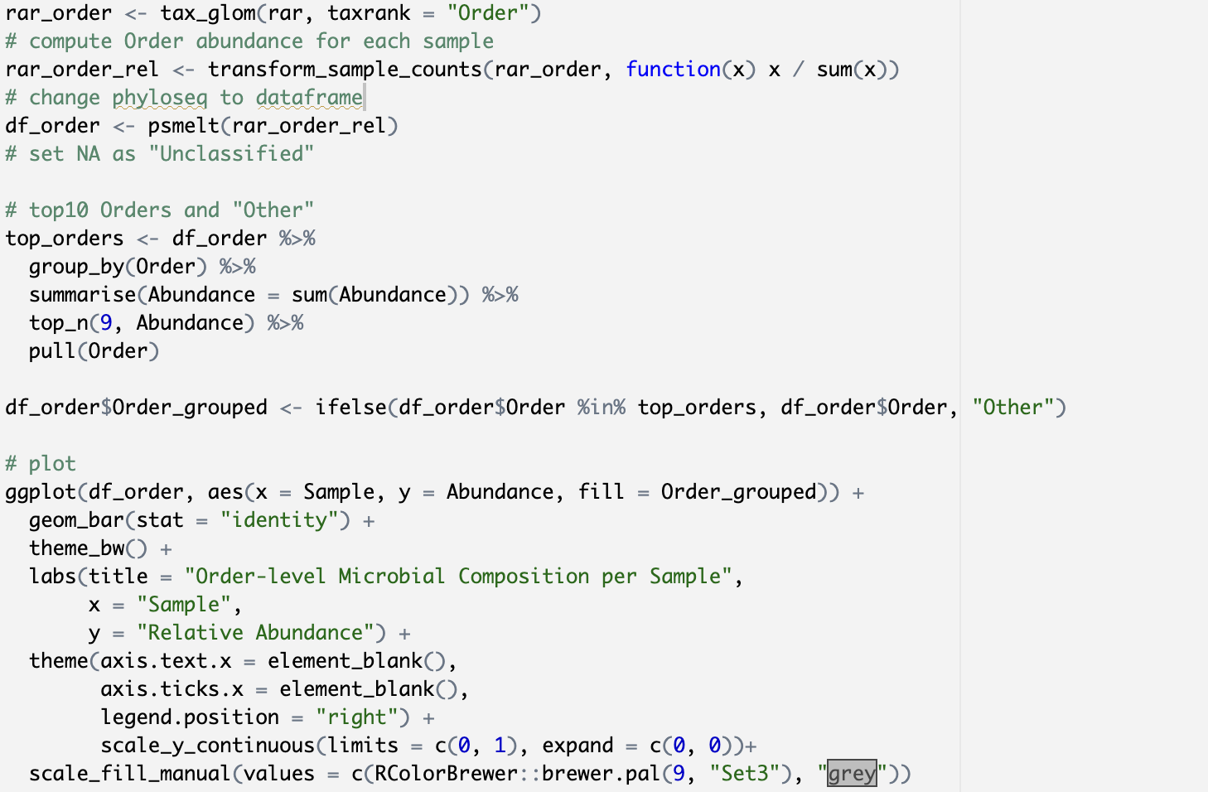
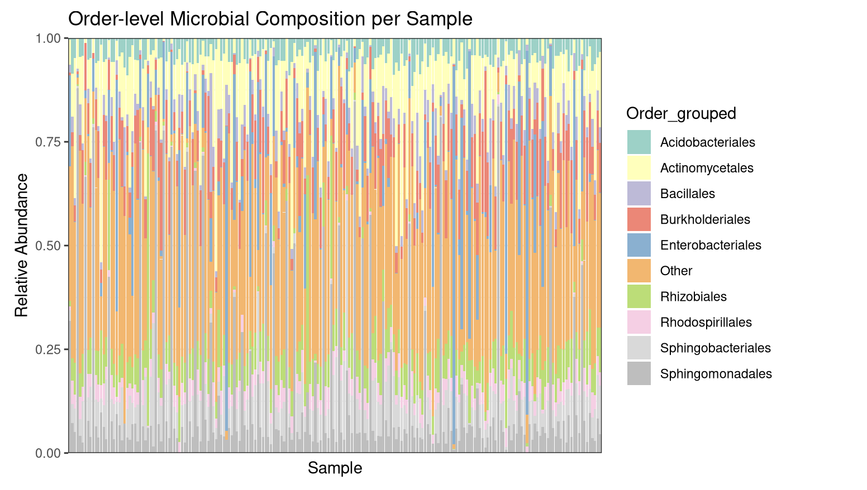
Taxonomy distribution
Deng et al., 2021

Slide 24
III Root transcriptome data analysis (4.6)
Preparation for the upcoming exercises

Slide 25
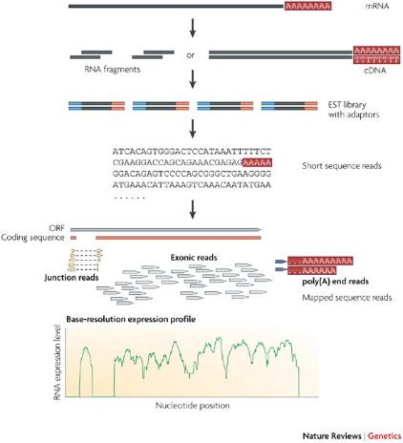
Transcriptome Sequencing
Research objective: To understand the standard RNA-seq data analysis workflow and construct an expression matrix.
Core Applications of RNA-seq
Quantifying gene expression levels
Detecting alternative splicingevents
Assembling transcripts (de novo or reference-guided)
Detecting gene fusions
(Wang et al.,2009, nature reviews genetics)
Notes:
Briefly, long RNAs are first converted into a library of cDNA fragments through either RNA fragmentation or DNA fragmentation (see main text). Sequencing adaptors (blue) are subsequently added to each cDNA fragment and a short sequence is obtained from each cDNA using high-throughput sequencing technology. The resulting sequence reads are aligned with the reference genome or transcriptome, and classified as three types: exonic reads, junction reads and poly(A) end-reads. These three types are used to generate a base-resolution expression profile for each gene, as illustrated at the bottom; a yeast ORF with one intron is shown.

Slide 26
RNA sequencing
1. Understanding Raw Sequencing Data
Check read quality using FastQC or MultiQC.
2. Read Trimming & Alignment / Quantification
Trim adapters and low-quality reads, then:Align reads to a genome (STAR, HISAT2), orQuantify directly using Salmon or Kallisto.
3. Gene / Transcript Quantification
Generate expression matrices (e.g., counts, TPM, FPKM).
4. Differential Expression Analysis
Identify differentially expressed genes using DESeq2, edgeR, or limma.
5. Data Visualization & Interpretation
Visualize patterns using PCA, heatmaps, volcano plots, etc.

Slide 27
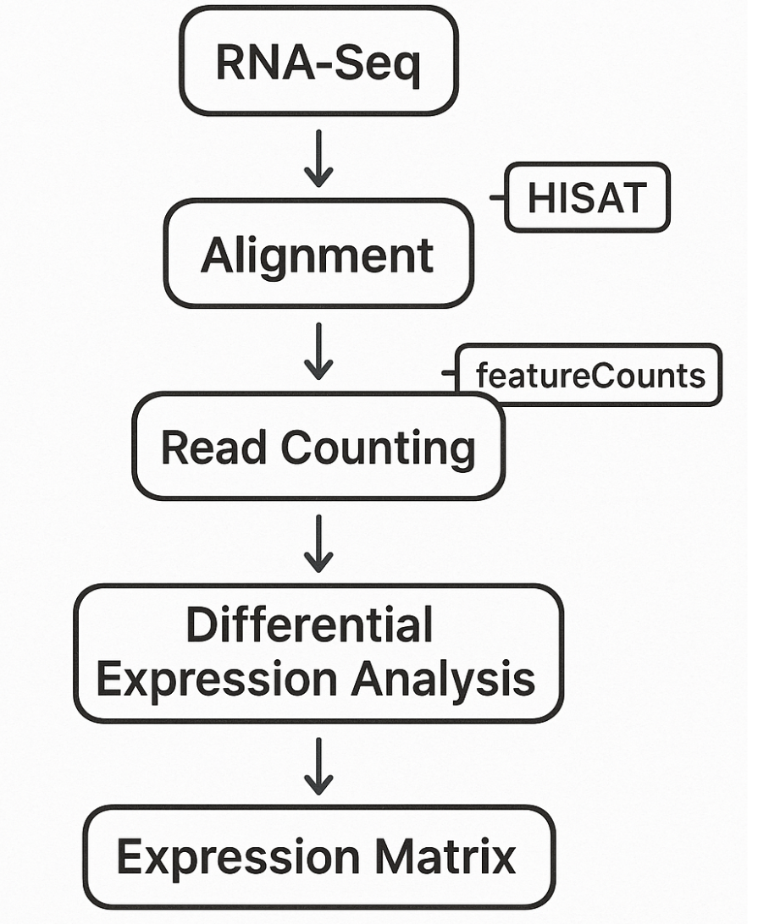
RNA sequencing data analysis pipeline
Code:
https://github.com/ttian627/Omics-Data-Analysis-of-Root-Microbe-Interactions/tree/main/02_RNAseq

Slide 28
IV Gene Expression – Microbiome Co-regulation Networks (11.6)
Preparation for the upcoming exercises

Slide 29
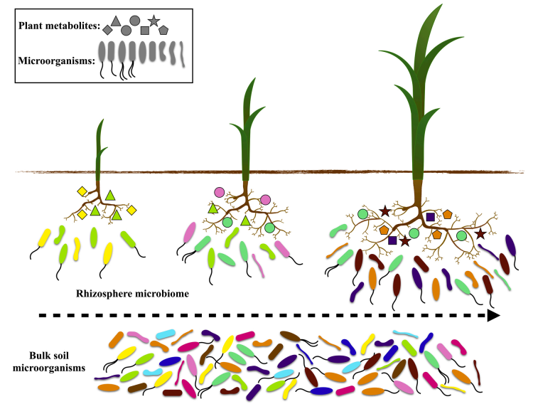
Root and Microbiome interactions
Research objective: To identify the regulatory relationships between specific gene expression and the abundance of specific microbes.
Genome
Transcriptome
……
Microbiome
(Zhang et al., 2021, Microbiological Research)

Slide 30
Microbiome Co-regulation Networks
Expression matrix
Microbiome ASV feature table
 | sample1 | sample2
Gene1 | FPKM1 | FPKM2
Gene2 | FPKM3 | FPKM4
Gene3 | FPKM5 | FPKM6
… | … | …
 | sample1 | sample2
class1 | count1 | count2
class2 | count3 | count4
class3 | count5 | count6
… | … | …

Slide 31
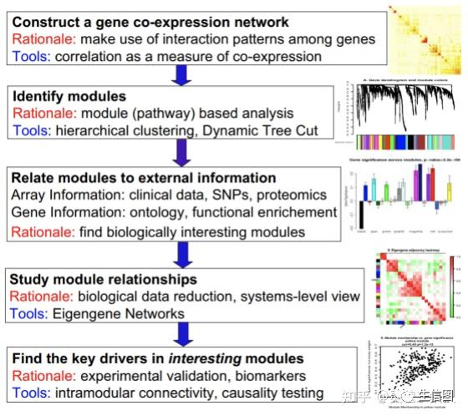
Microbiome Co-regulation Networks

Slide 32
Microbiome Co-regulation Networks
Code
https://github.com/ttian627/Omics-Data-Analysis-of-Root-Microbe-Interactions/03_Co-regulation Networks/

Slide 33
Thank you
Preparation for the upcoming exercises
Lecturer Assistant
Tian Tian
Plant Genetics – Department of Molecular Life Sciences – School of Life Sciences

